Slide 1

EDUCATION
This Photo by Unknown Author is licensed under CC BY-SA
Presenters:
Coaches: Karen Cortez, Yesenia De La Rosa & Sara Corona

Slide 2

Overview:
Introduction to Parents/Families
Teacher Home Visit
Teacher/Parent Conference
School Readiness Goal/ ELOF Framework
Milestones

Slide 3

Meet The Teacher/ Welcome to EHS!
August 28-September 3,2020
EHS teachers contact your parents and welcome your children to Early Head Start! August 28-September 3 2020
Introduce yourself as the teacher
Ask parent what is the best way of communication for them for future meetings/ conferences and etc.
Write down any important information and always document on your contact log when you have contacted parents.
This is the best opportunity for you to get to know your parents and child.

Slide 4
1st Home Visit
September 21-Oct 2
All forms/ resources will be available on website under “Education”
Be sure to schedule a home visit time with parent that is best convenient for them.
Be prepared with all forms that you will need to fill out virtually:
-Parent Notice
-Home Visit Form
-Home Language Survey
-ASQ3 screener / ASQ calculator
-e-DECA screener
-Milestones
-School Readiness Goals (parents)

Slide 5
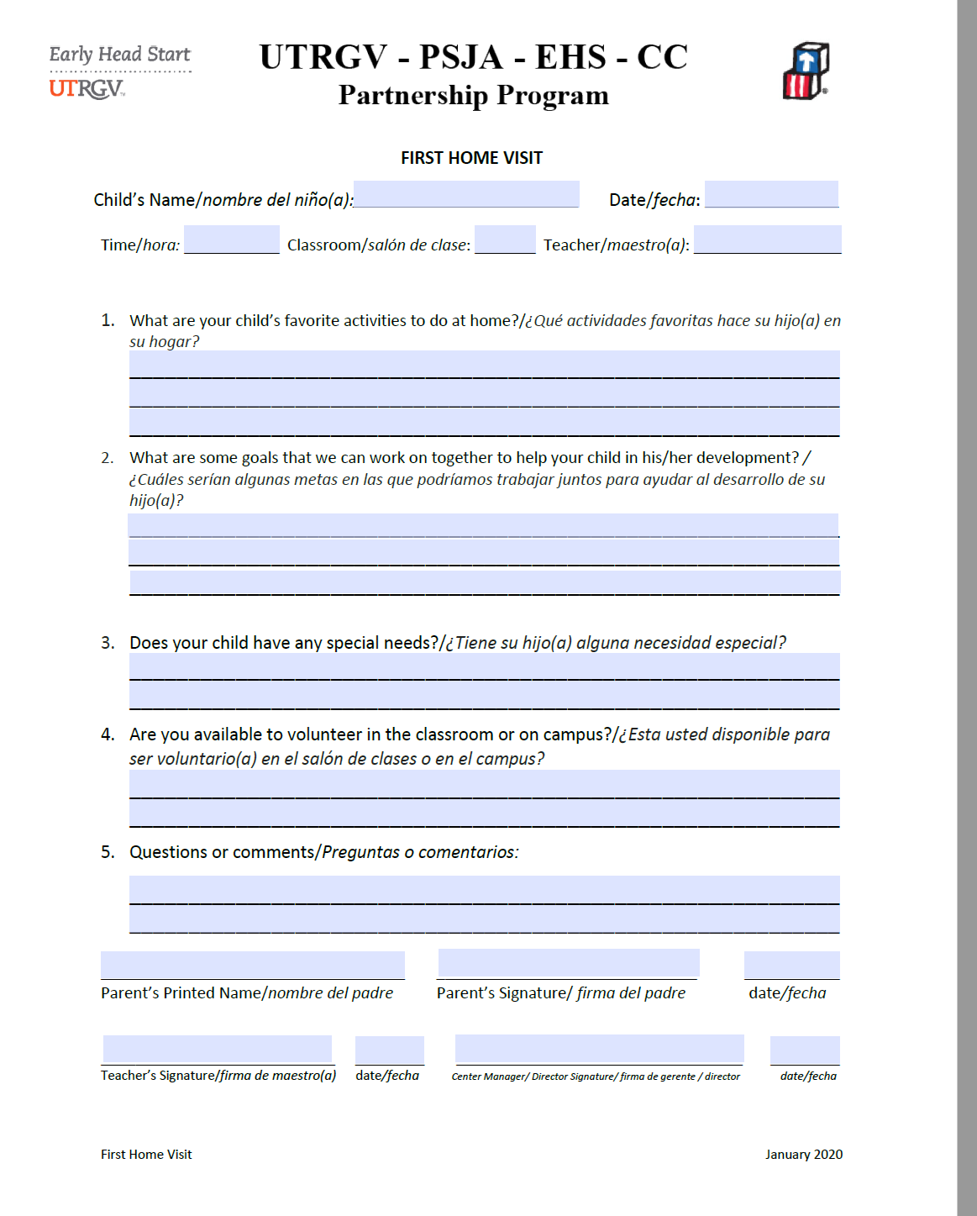
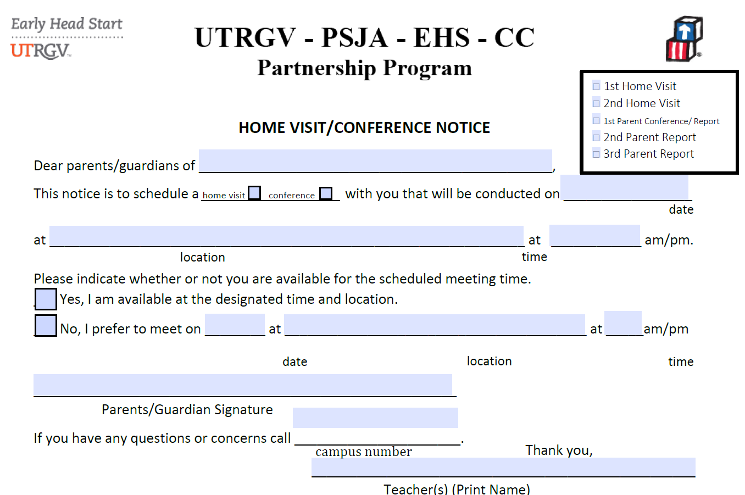

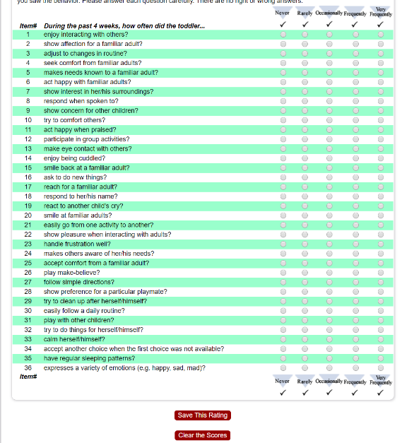



All forms are available on website under “Education”

Slide 6
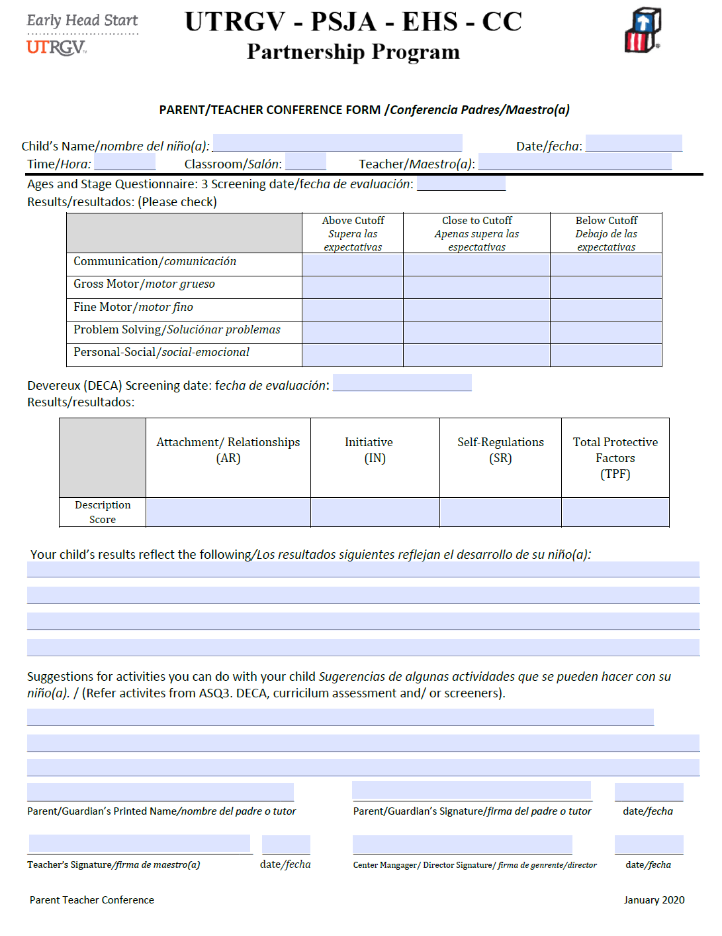
1st Parent Teacher Conference
October 12-October 23
1st Parent Conference IS ONLY based on screeners
Be prepared to share the ASQ3 and E-DECA summary and overview with parent.
Share some ASQ3 strategies/ E-Deca strategies with parent
DECA Strategies are available on the e-DECA website and EHS website under Education / Disabilities
SAVE AND UPLOAD into One Drive labeled as: 1st Parent Conference

Slide 7


AIMS Parent Teacher Conference
November 18-25
Includes: Parent Notice Form / AIMS Parent Teacher Report

Slide 8
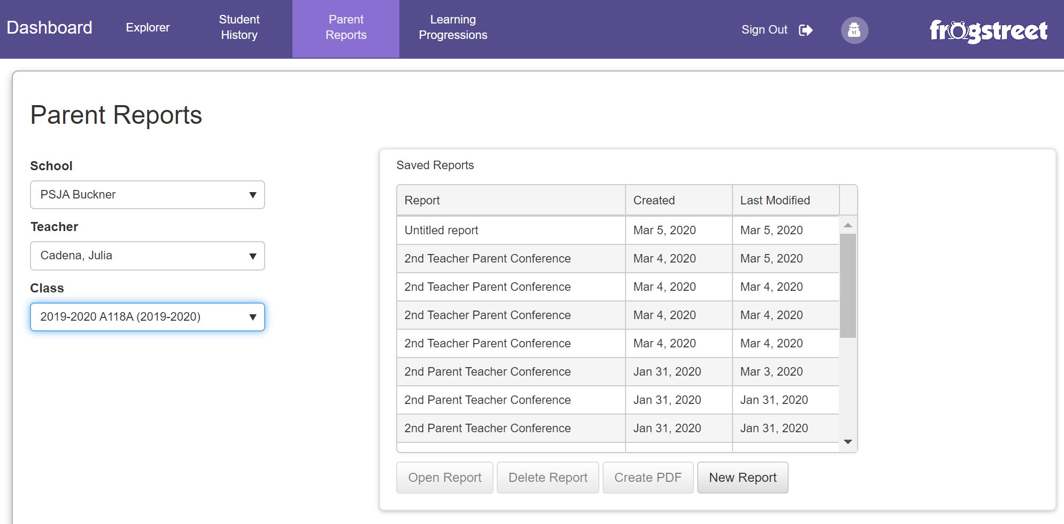

Slide 9
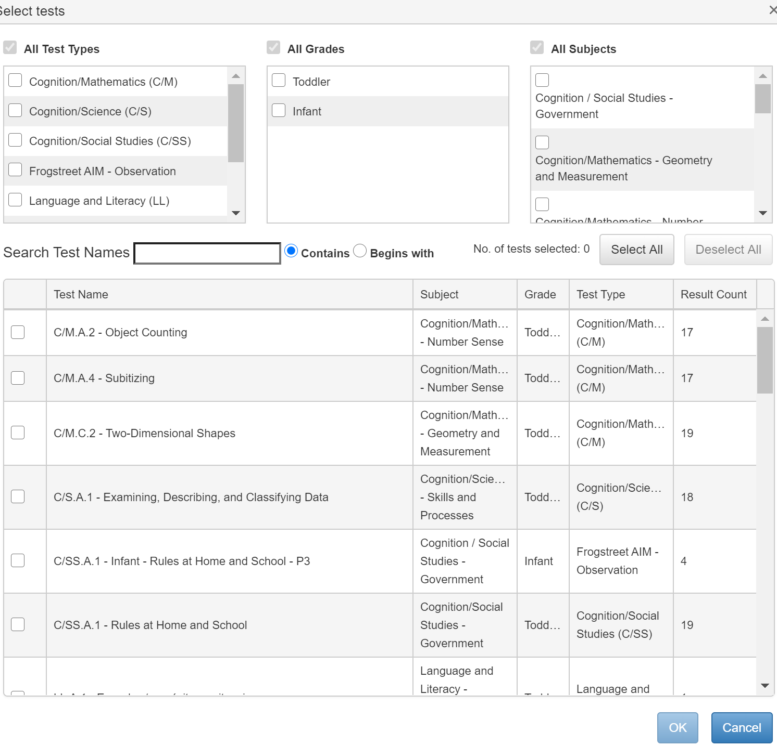
Choose all subjects
Pick a minimum of 2-3 per domain in
-Cognitive
-Social
-Language
-Physical
Then click on “OK”
“What you decide to share with parent be sure to share all the information with parent.

Slide 10
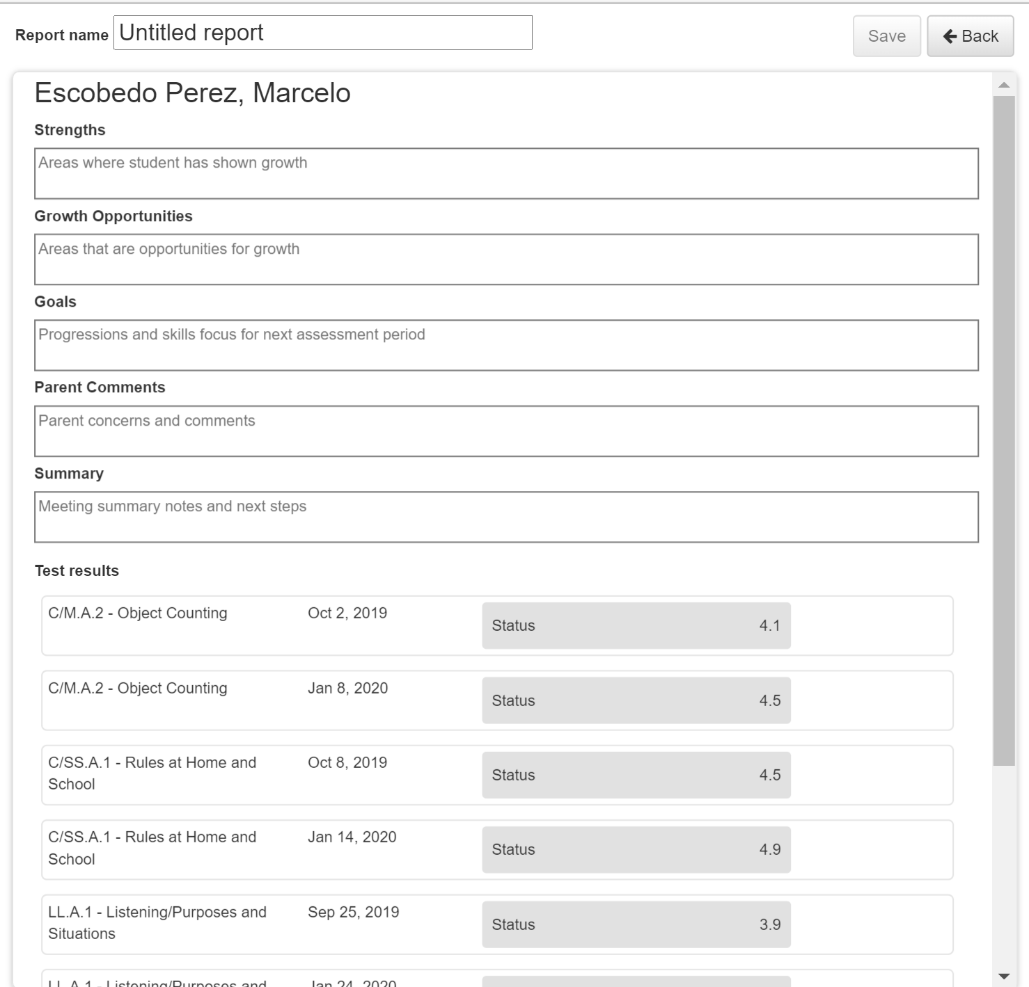
Completing the Parent Report
Label Report: BOY Parent Conference
Add 1-2 child’s strengths
Add an area of growth opportunities
Add 1-2 goals upon next checkpoint
IF any parent comments add or put “ no comments”
Summary: Next checkpoint is MOY Feb 22-26
Test Results: Choose what you would like to share with parent but ensure what you choose you must share with parent.

Slide 11
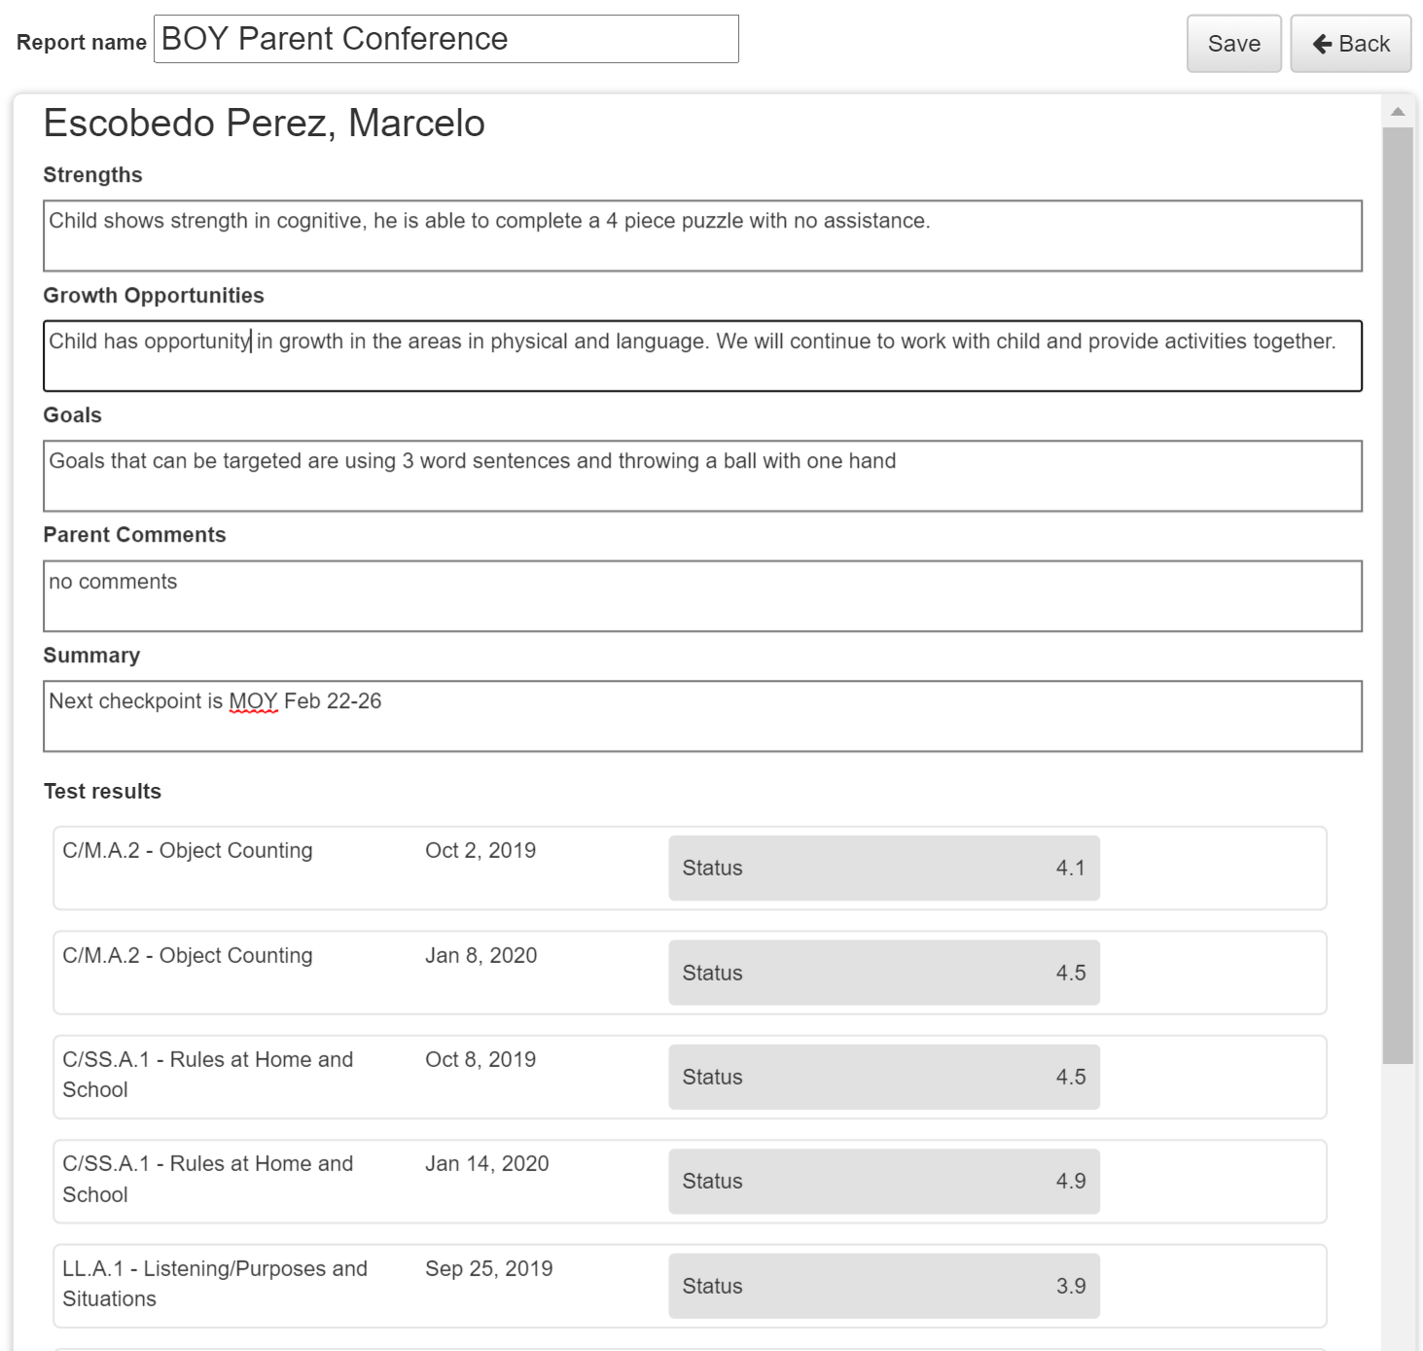


Slide 12

SAVE and upload Parent Conference under the One Drive system on a new folder labeled “Parent Conference BOY
These same steps will be followed for the 2nd (BOY) & 3rd (MOY) & 4th (EOY) Parent Conference. Follow the same exact steps.

Slide 13
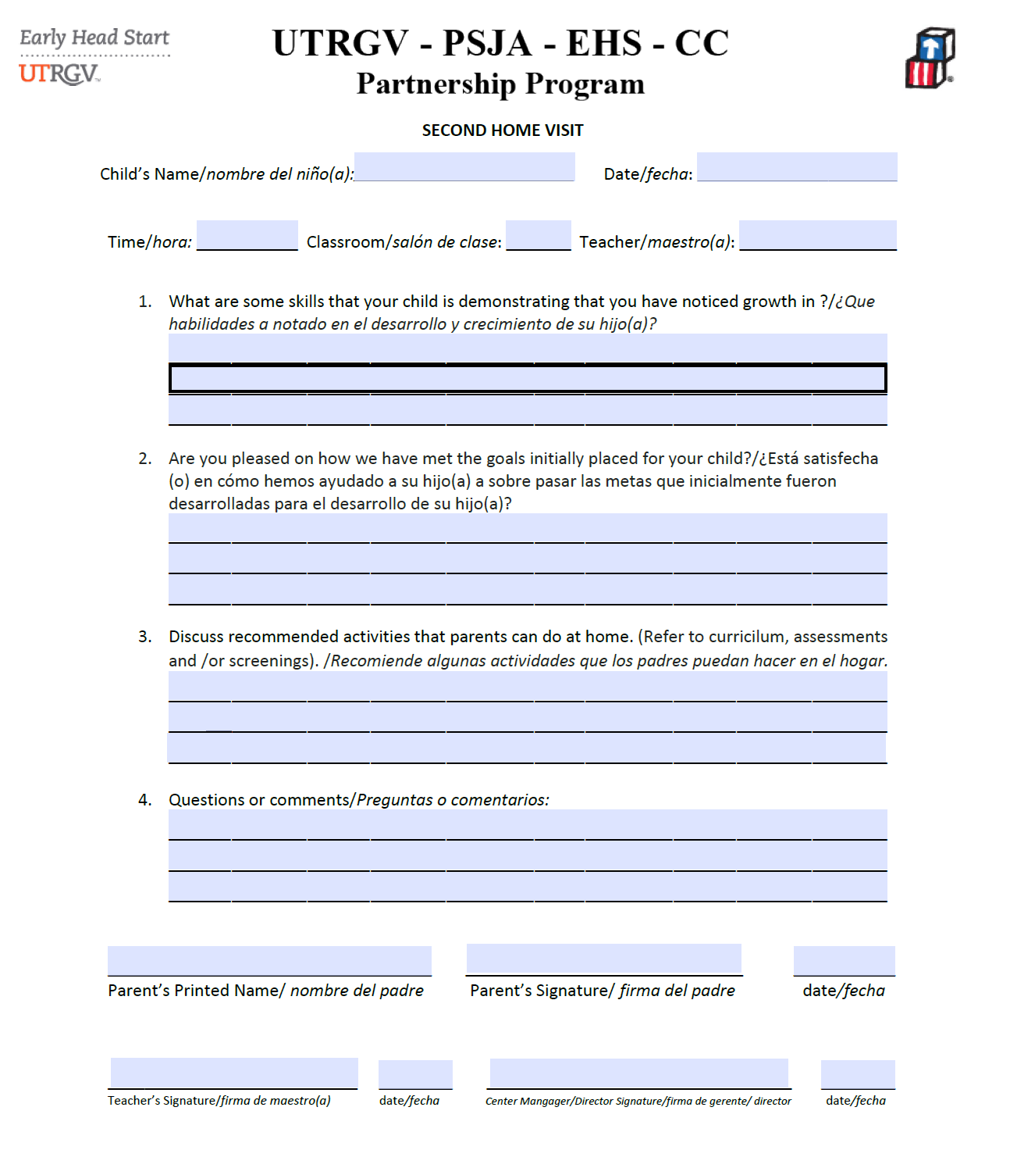
2nd Home Visit
Complete and fill out Parent Notice 2nd Home Visit
Save and upload into One Drive labeled as 2nd Home Visit
Be sure Home Visit is dated the day it is conducted.

Slide 14
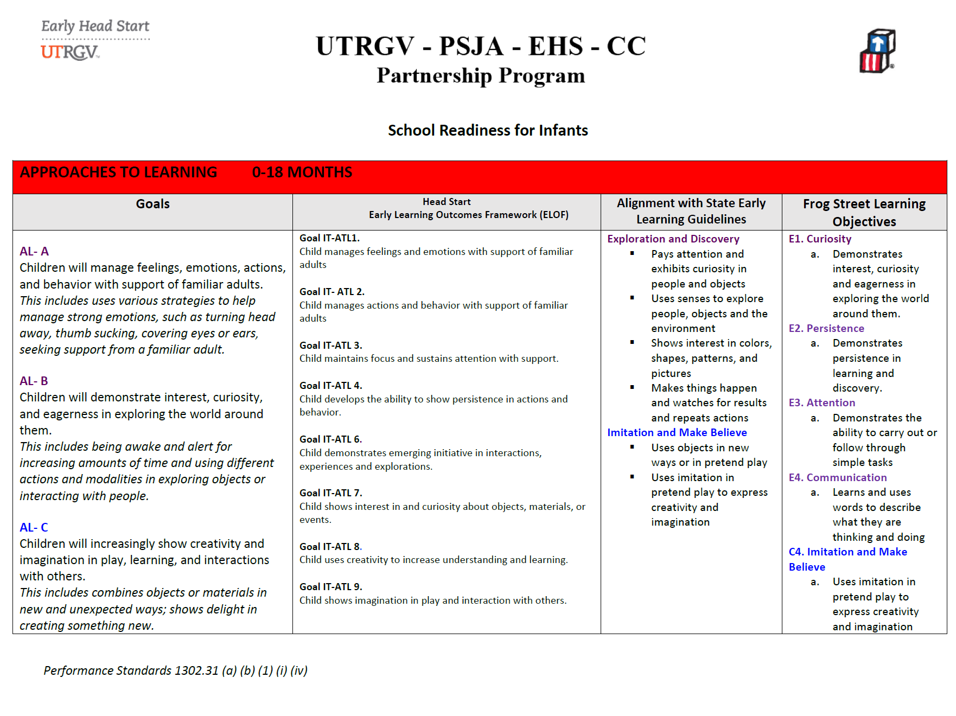
Reminder:
Use all resources you have available to you:
School Readiness Goals
ELOF Framework
ASQ3/E-DECA Strategies
Milestones of Development
School Readiness Goals will be up on website under “Education”

Slide 15
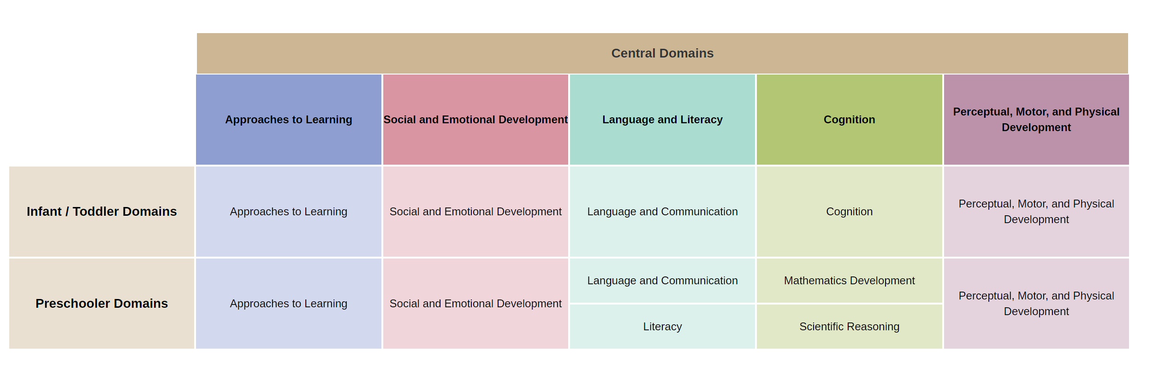
Head Start Early Learning Outcomes Framework Ages: Birth to Five

Slide 16


